Slide 1

Burmese
or®musrf;pm
tkwfNrpf
Texas jrdk.rS or®musrf;pm-tkwfjrpf (edkifiHwumtrSkawmfaqmifvkyfief;)
\ wifjycsuf
www.biblebasically.org
Dr ရက္ခ္ ဂရီဖိတ္၊ စကၤပူဓမၼေကာလိပ္ • www.BibleStudyDownloads.org

Slide 2



(jzpf&onfhtajumif;t&mrsm;)
or®musrf;pm tajccHususavhvmjcif;
®
tydkif; 5
or®musrf;pm tajccHtkwfjrpf
©2004 TBBMI
8.0.05a.
02

Slide 3

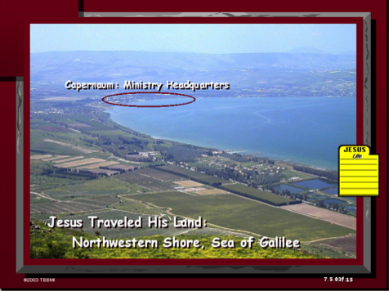
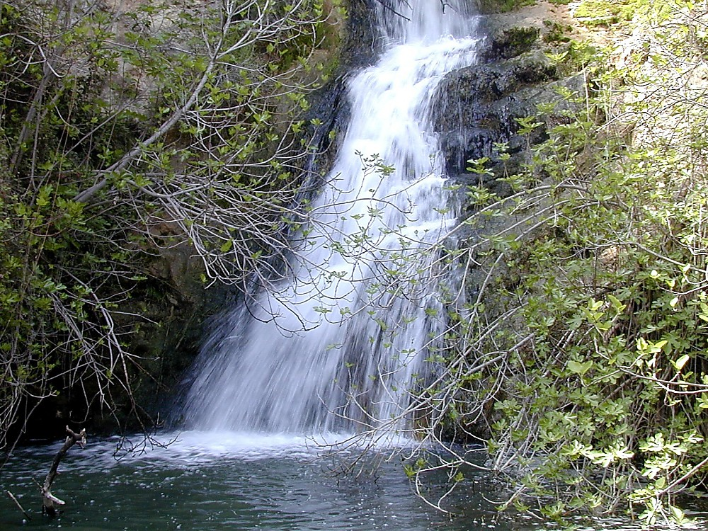
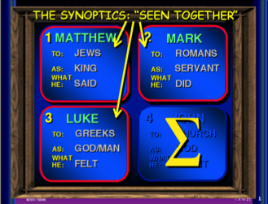
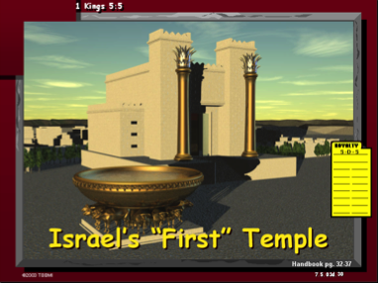
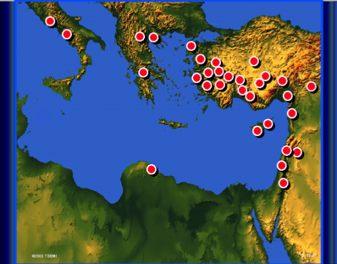
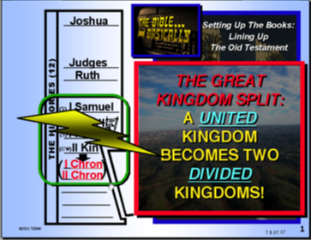
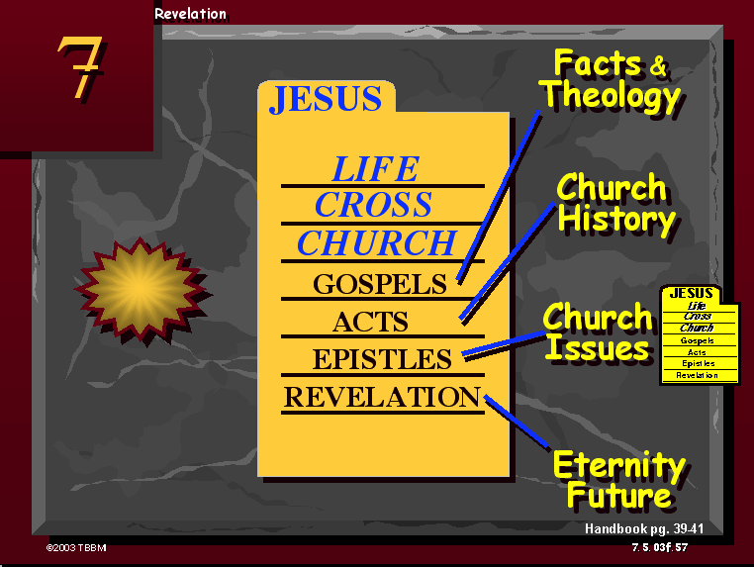

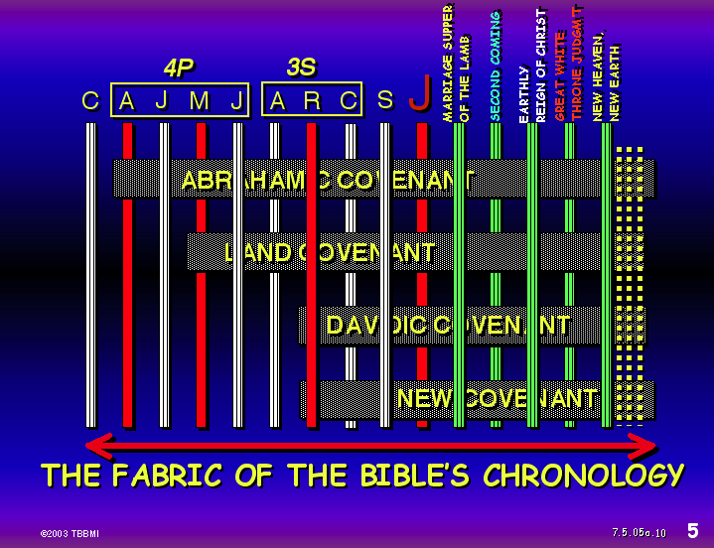
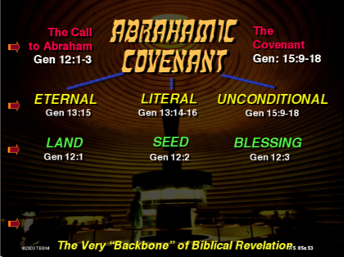
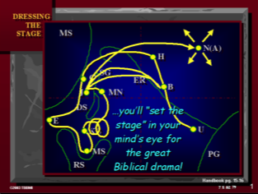

03
©2004 TBBMI
8.0.05a.

Slide 4
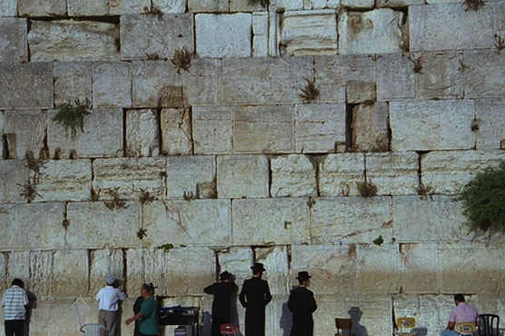
orRmusrf;pm
ta_ccHtkwf_rpf
tpjyKonf.ae&m
©2004 TBBMI
8.0.05a.
04
1

Slide 5



ao;i,faomtyfcsnfrsSifrsm;,ufaeonfudk[k atmufarhyg
tpDpOfvdkufzGJGUpnf;xm;
aomor®musrf;pm
pmoiftaxmuftul trSwf- 08
© 2004 TBBMI
8.0.05a.
05

Slide 6
tpDpOfvdkufzGJhxm;aom or®musrf;pm
7
vlrsKd;4rsKd;
vlhtodkif;t0dkif; 3 ck
J
zef
tm
,m
arm
&+
rJh
bk
odrf;
jidrf
pkpnf;xm;aom pum;pkq,fpk
© 2004 TBBMI
8.0.05a.
06
1

Slide 7
or®musrf;pm\ tpOfvdkufjzpfzGJhpnf;ykH
7
vlrsKd;4rsKd;
vlhtodkif;t0dkif; 3 ck
J
zef
tm
,m
arm
&+
rJh
bk
odrf;
jidrf
zefqif;jcif;
tmjA[H
a,moyf
arma&S
a,m&I
rif;rJhumv
pdk;pHumv
zrf;qD;umv
qdwfjidrfumv
a,&I
© 2004 TBBMI
8.0.05a.
07

Slide 8
orRmusrf;pm tpOfvdkufzGJhpnf;yHk
7
4vlrsKd;4rsKd;
3vlhtodkif;t0dkif; 3 ck
J
zef
tm
,m
amr
&+
rJh
bk
odrf;
_idrf
zefqif;_cif;
tm_A[H
a,moyf
aemufqHk; aomumv
arma&S
a,m&+
rif;rJhumv
pdk;pHumv
odrf;oGm;csdef
_idrfoufcsdef
a,&I
© 2004 TBBMI
8.0.05a.
08

Slide 9
orRmusrf;pm tpOfvdkufzGJhpnf;yHk
7
vlrsKd;4rsKd;
vlhtodkif;t0dkif; 3 ck
ocifa,&+avmuudk tkyfpdk;_cif;
'kkkwd,tjudrfjuGvm_cif;
owdkhom;r*fgvmaqmifyGJ
aumif;uifopfeSifha_r }uD;opff
J
GRyvif_zLw&m;pD&if_cif;
zef
tm
,m
arm &+
rhJ
bk
odrf;
_idrf
zefqif;_cif;
tm_A[H
a,moyf
aemufqHk;
aomumv
arma&S
a,m&+
rif;rJhumv
pdk;pHumv
odrf;oGm;csdef
_idrffoufcsdef
a,@+
© 2004 TBBMI
8.0.05a.
09
4

Slide 10
or®musrf;pmtpOfvdkufzGJ h pnf;ykH
7
4 -vlrsKd;4rsKd;
3 -vlhtodkif;t0dkif;3ck
owdkhom;r*fvmaqmifyGJ
aumif;uifopfeSifhajrjuD;opf
'kwd,tjudrfjuGvmjcif;
yvifjzlw&m;pd&ifjcif;;
J
avmuudktkyfpdk;jcif;
zef
tm
,m
arma&S
rJh
bk
odrf;
jidrf;
tmjA[H y#dnmOf
ajrydkifqdkifrI y#dnmOf
'g0d'fy#dnmOf
y#dnmOfopf
© 2004 TBBMI
8.0.05a.
10
5

Slide 11
or®musrf;pmzGifhjycsuf\t"duusaom ajum&kd;
tajctaeay:wGifrrlwnfaom bk&m;ocif\ y#dnmOf
tpDtpOf
11

Slide 12
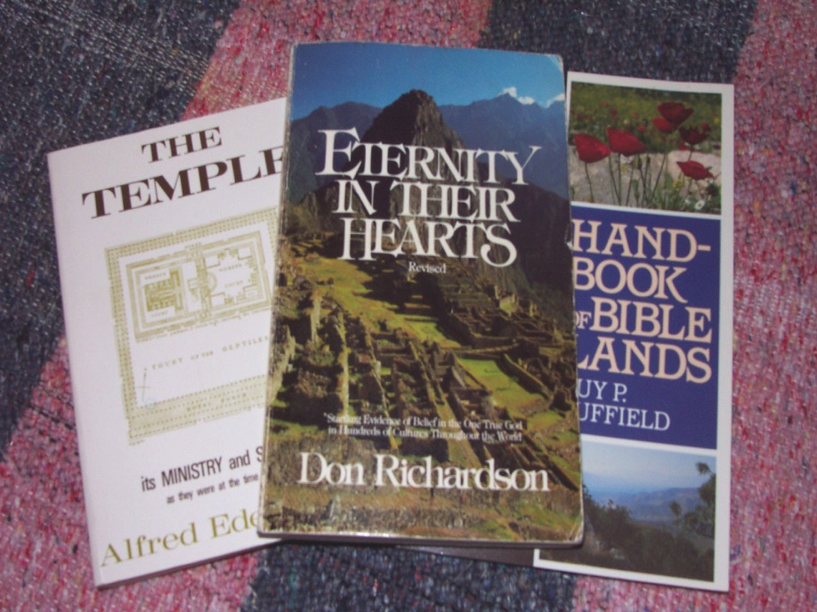
or®musrf;pmajum&kd; / tajctaeay:wGifrrlwnfaom bk&m;ocif\y#dnmOftpDtpOf
Don Richardson, Eternity in Their Hearts
12

Slide 13
or®musrf;pmaBum&dk;/ tajctaeay:wGifrrlwnfaom bk&m;ocif\y#dnmOf tpDtpOf
tmjA[H\Hy#dnmOfonf or®musrf;pm\t"duaBum&dk; eSifh txl;jyK xm; onfh aBum&dk;aumfvHjzpfonf? xdkhaBumifhþ
taBumif;t&mudk vspfvsK &IaomoGefoifrIonf t"duusaom@wckckwGif tvGef tm;enf; aeygvdrfhrnf?
trSefpifppf a}um@dk;r@dSaomudk,fcE<m[k qdkvdkygonf? xdkr#ru rdrd vl rsKd;xHomru vlrsKd;wumwdkhxHodkh bk&m;ocif.aumif;}uD;r*Fvmrsm; vufqifhurf; ay;&rnfhtpm; c&pf,mefrsm;tm; tm;ay;v+Hhaqmfr+ avsmhenf;ap&m a&mufygonf? (Pg. 163)
Don Richardson, Eternity in Their Hearts
13
2

Slide 14
or®musrf;pmaBum&kd;/ tajctaeay:wGifrrlwnfaom bk&m;ocif.y#dnmOftpDtpOf
“tjypf ”
a[jAJbmom eSifh *&dbmom/
rSm;,Gif;aomtjyKtrl
tvGefqdk;npfjcif;
usL;vGefjypfrSm;jcif;
aumufuspfpOf;vJjcif;
usL;ausmf0ifa&mufjcif;
raumif;qdk;0g;
pmoiftaxmuftul trSwf -10
14
8

Slide 15
or®musrf;pmaBum&kd;/ tajctaeay:wGifrrlwnfaombkl&m;ocif\y#dnmOftpDtpOf
odkhaomf…þuJ.odkUoifpOf;pm;aumif; pOf;pm;aevdrfhrnf…
“tjypftaBumif;
a[jAJbmom eSifh *&dbmom/
urÇmajrBuD;\tajctae tqifhtwef;ub,frSmvJ?
“jypfrSwfvGJonf”
15
2

Slide 16
or®musrf;pmajum&kd;/ tajctaeay:wGifrrlwnfaom bk&m;ocif\y#dnmOf tpDtpOf
tjypf [laompum;vkH;eSifhywfoufí
a[jAJbmom? *&dbmom--jypfrSwfvGJacsmfonf/
jyxm;aomrsSm;twdkif; / or®musrf;pmudkcsufjcif;oGm;ízwfyg/
“aumif;uifbkHwGif&Sdaomoifwdkhtbonf oefh&Sif;awmfrlonfh enf;wl oifwdkhonfvnf;oefh&Sif;jcif;&SdBuavmh/” róJ 5;48
16
1

Slide 17
htb\ah&Sae h h h teEW h h h tmvmz h h h tmrif h h h h ueOD;aeh&ufrsm; h h h
bdodufcHol h h h wrefawmf eSifh ,mZfya&m[dwf h h h bk&m;ocif\vuf&Hk;awmf h h h
touf\tp h h h,HkBunfjcif;tpjyKol h h htp eSifh tqHk; h h h
aumif;jrwfaomtkyfpdk;&Sif h h h touf h h htoufrkefh h h hbk&m;ocif\rkefh h h howdkhom; h h hrdk;aomufBu,f h h hodk;xdrf;BuD; h h ha&;G;aumufjcif;cHol h h h wyg;wnf; h h c&pfawmf h h hbk&m;ocif\c&pfawmf h h hocifc&pfawmf h h h touf@Sifaombk&m;ocif\om;awmf/c&pfawmf h h h eSpfodrfhol h h h h trdefhay;ol h h h h tpfa&;vlrsdK;twGufeSpfodrfhol h h havmifaomrD; h h wdkufa'gif.ausmuf h h hwdkifyifbuf h h hzefqif;&Sif h h hvSTwfajrmufapol h h hvlom;tm;vHk;.arsmfvifh&m h h hwHcg; h h ht,fvf&Sm'dkif; h h hxm0&bk&m; h h hxm0&tb h h htjzpfrSefudkwduspGmzGifhjyol h h hopPm eSifh orRmw&m; h h hrSefaomoufao h h htb h h t&m&mtm;vHk;\om;OD;h h h tOD;oD;aomtoD; h h htkwfjrpf h h htcGefcHeSifhtjypfom;rsm;\rdwfaqG h h hodrfarG h pGmudk;uG,fol h h hbk&m;ocif.qkaus;Zl; h h hbk&m;ocif.bkef;awmf h h hbk&m;ocif h h hteEWbk&m;ocif h h ht&mcyfodrf;wdkh.bk&m; h h huGsefKyfudkjrifaeaombk&m; h h haumif;aomodk;xdrf; h h hBuD;jrwfaom,Zfya&m[dwf h h hBuD;jrwfaomodk;xdef; h h hvrf;jy&SSif h h hOD;acgif; h h htoif;awmf.OD;acgif; h h ht&mtm;vHk;.tarG h h hxm0&m,Zfya&m[dwf h h hoefh&SSif;aomol h h htpfa&;vlrsKd;.oefh&Sif;aomol h h hoefh&Sif;aom0dnOfawmf h h harQmfvifhjcif; h h hu,fwifjcif;OD;csKd h h hig h h hbk&m;ocif.yHko@mef h h hrdrdyHko@mef h h h{rmaEGv h h ha,a[m0g h h ha,&I h h hocifa,&Ic&pfawmf h h w&m;olBuD; h h &Sifbk&if h h hxm0&&Sifbk&if h hh hbk&ifwumhbk&if h h havmubk&if h h hbk&m;ocif\odk;oi,f h h haemufqHk;tm'H h h hydnwfawmfay;ol h h hacgif;aqmif h h htouf h h havmutvif; h h hodef;iSufuhJodkh h h hawmESif;yef; h h h,k' jcaoFh h h htouf&Sifaomausmuf h h htoufprf;a& h h hocif h h ht&Sifocifbk&m; h h hocifa,&Ic&pfawmf h h hocifwumhocif h h hbkef;BuD;ocif h h ht&Sifwum;t&Sif h h hajzmifhrwfawmfrlaomocif h h hjcpfjcif’arwWm h h h0rf;enf;aBuuJGaomol h h hocif h h hBum;cH h h hoem;Buifemaombk&m; h h hemZ&if; h h 'hg0d'frSqif;oufol h h hwpfarCm h h hwOD;wnf;aomom; h h hyocgodk;oi,f h h uGsefKyfwdkU\jidrfoufjcif; h h htdk;xdrf; h h hbk&m;ocif.wefcdk; h h hjidrfoufjcif;t&Sif h h hya&mzuf h h hoefhpifapol h h h&mbdkifh hh(q&m) h h hbk&m;ocif.bkef;awmfa&mifjcnf h h ha@G;eSKefaomol h h hoefhpifapaomrD; h h hxajrmufjcif;eSifhtouf h h ha_zmifhrwfaomol h h hausmuf h hhhhhhh h h h 'hg0d'f.tjrpf h h hh&Sm&kefESif;qD h h hzefqif;xm;aomt&mtm;vHl;udktkyfpdk;ol h h havmubk&ifrsm;.bk&if h h htpPa&;bk&if h h hu,fwif&Sif h h htpPa&;vkrsKd;xJrS h h hrsKd;aph h h htapcH h h hodk;xdrf;ESifhpdwf0dnmOfudktkyfpdk;aomol h h h tuG,ftum h h 'hhg0df'fom;awmf h h hbk&m;om;awmf h h h,mukyf.}u,f h h hausmuf h h hajzmifhrwfjcif;.om;awmf h h hq&m h h hrSefaomtvif; h h horRmw&m; h h hpyspfEG,f h h hbk&m;ocif.ynm h h htHh}obG,fwdkifuifbuf h h heSKwfuywfawmf h h hbk&m;ocif.eSKwfuywfawmf h h h
bkef;BuD;awmfrlaom bk&m;ocif\emrawmfrsm;
a,&I
ocifc&pfawmf
ocifc&pfawmf
ocifc&pfawmf
Mary Foxwell Loeks, The Glorious Names of God
oifaxmuful trSwf -11
uGseKfyfwdkh jypfrSwfvGJovm;-rvGJbl;vm;?
17
8

Slide 18
ousrf;pmaBum&dk;/ tajctaeay:wGifrrlwnfaom bk&m;ocif\ y#dnmOf tpDtpOf
tjypfeSifhywfoufí
xdktajumif;t&mudk rnfolrSef;qekdifygrnfenf;?
&Sifaygvku a&mrjo0g þodkhqdkxm;ygonf a&mr 3;23
18
1

Slide 19
vltaygif;wdkhonftjypfjyKBuaomaBumif. bk&m;ocifa&SUawmfwGif toa&ysufBujyD/
19

Slide 20
or®musrf;ajum&kd;/ tajctaeay:wGifrrlwnfaom bk&m;ocif\ y#dnmOftpDtpOf
orRmusrf;
orRmusrf;
pdwfqEN
topf
pdwfqEN
topf
pdwfqEN
y#dnOf
y#dn1Of
y#dnOfpmcsKyf
y#dnmOf pm csKyf
y#dnmOf
y#dnmOf
pmcsKyf
y#dnOfpmcsKyf? or®musrf;pm
oifaxmuful trSwf -12
20
19

Slide 21
or®musrf;pmaBum&dk;/ tajctaeay:wGifrrlwnfaom bk&m;ocif\ y#dn1Of tpDtpOf
a&S;acmwfumv
y#dnmOfrsm;
eSifh
pmcsKyfrsm;
21

Slide 22
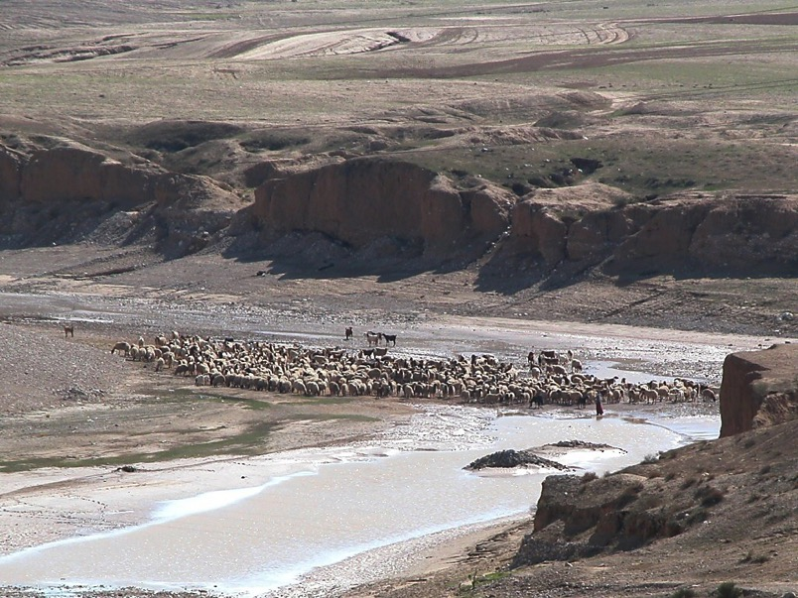
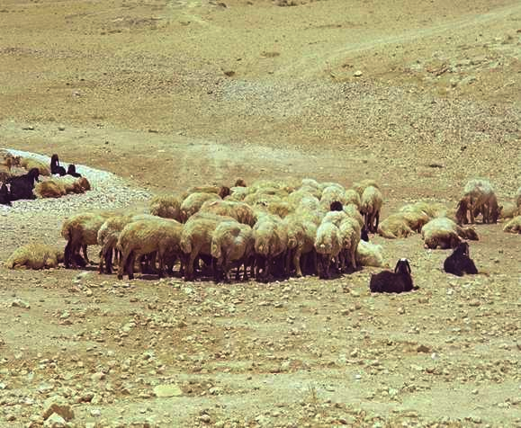
oifaxmufultrSwf -13
or®musrf;pmajum&dk;/ tajctaeay:wGifrrlwnfaom bk&m;ocif\ y#dnmOftpDtpOf
a&S;acmwfy#dnmOfrsm;
22
1

Slide 23
{Z&m 10;19? aZ,ausv 17;18
or®musrf;pmajum&dk;/ tajctaeay:wGifrrlwnfaom bk&m;ocif\ y#dnmOftpDtpOf
a&S;acmwfy#dnmOfrsm;
• vuf
23

Slide 24
&ko 4;8
or®musrf;pmajum&dk;/ tajctaeay:wGifrrlwnfaom bk&m;ocif\ y#dnmOftpDtpOf
a&S;acmwfy#dnmOfrsm;
• vuf
• zdeyf
24

Slide 25
0wdjyk&musrf; 2;13/ awmvnf 18;19/ 2&mcsKyf13;5
or®musrf;pmajum&dk;/ tajctaeay:wGifrrlwnfaom bk&m;ocif\ y#dnmOftpDtpOf
a&S;acmwf y#dnmOfrsm;
• vuf
• zdeyf
• qm;
25

Slide 26
urÇm 15
or®musrf;pmajum&dk;/ tajctaeay:wGifrrlwnfaom bk&m;ocif\ y#dnmOftpDtpOf
oifaxmuful trSwf -08
ueOD;acwfy#dnmOfrsm;
(bk&m;) udk,fwdkifjuGvmjyD;(rl&if; -“jzwfonf”) tmjA[HeSifhjyKvkyfonfhpmcsKyfxkH;pH(tmjA[Hy#dnmOf) bk&m;ocifudk,fwdkif “usdefqdkonf/” (pmcsKyfudktwnfjyKonf) wjcm;vlr&Sd/ “udk,fhudkudk,fwdkifwnfífusdefqdkon/f” (a[jAJ 6;13). trSefpifppf wzufowfqefaom y#dnmOfjzpfonf- xdkhajumifh *wdawmfonf tvGefckdifvHkonf/”
Walvoord/Zuck, The Bible Knowledge Commentary
“taoG;eSifhzGJ honfh y#dnmOf” vufrSwfa&;xdk;ol wpfOD;wpfa,muf raorcsif; y#dnmOfonftouf&Sifonf/
X
X
X
X
X
X
X
X
X
X
X
X
• taoG;
26
5

Slide 27

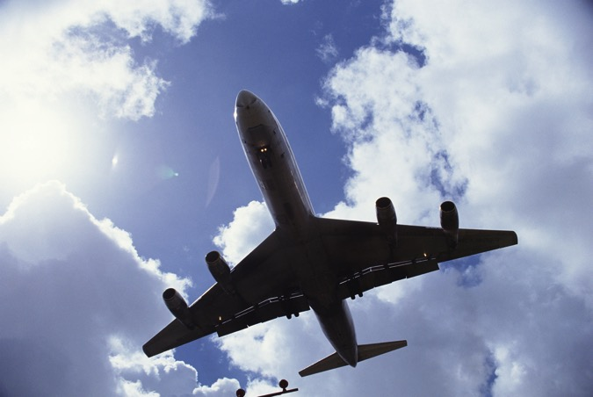

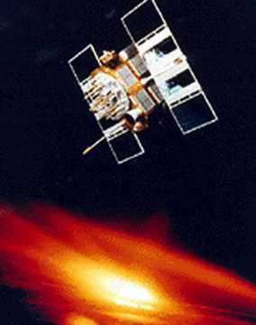
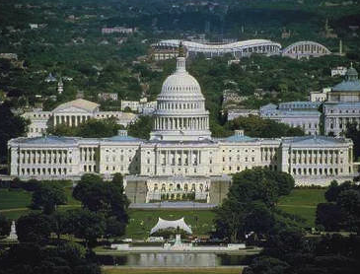

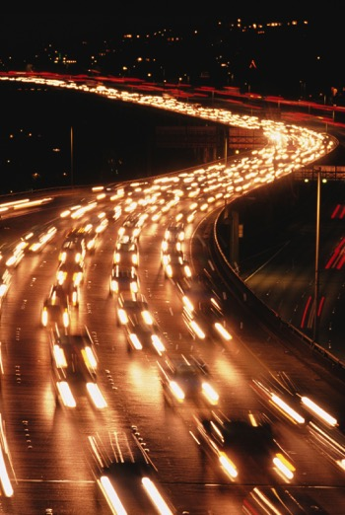
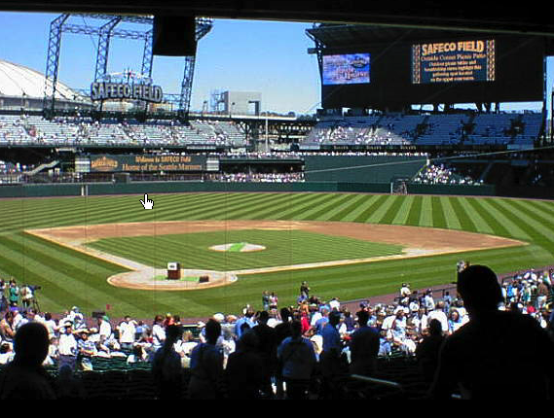
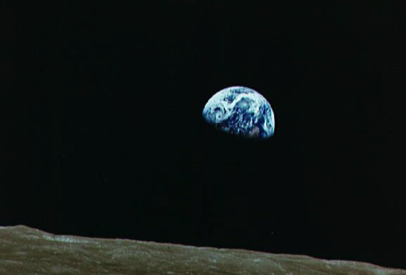
wvHk;w0wnf;udkifaqmifxm; onfht&mrsm;ubmvJ?
27
1

Slide 28
tar&dueftajccHOya' tar&duef\t"dutoufaoG;aBum?
28

Slide 29
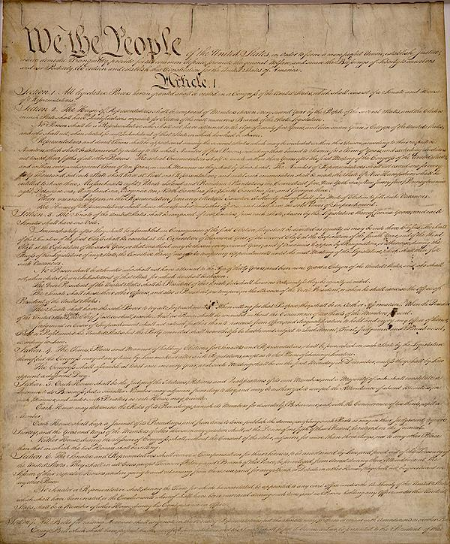
vlom;eSifh þtpdk;&tBum; w&m;0ifem;vnfrItcsuftvufrsm;
tar&dueftpdk;&\rlOya' tar&dueftpdk;&\ t"dutoufaoG;aBum?
29
1

Slide 30
zdwfac:_cif;
cv'J bme
S - D - S
owif;aumif;
40
odeawmif
jo0g'p1rsm;
a,&dacg
eSpf_crf;uGJonf
430
toif;awmf
xGufa_rmuf&musrf;
eSpfaygif; 70
uUKoa&v
ya&mzufrsm;
J - E
wrefawmf
usGefcH_cif;
w&m;oljuD;rsm;
,k'
350
L - S - B
I - I
As1'dwfusrf;
vlrsKd; 12 rsKd;
M - C - C
Z - E - N
w&m;a[mcsuf 5 ck
c&D;&Snf 3 ck
30

Slide 31
zdwfac:_cif;
cv'J bme
S - D - S
owif;aumif;
40
ode
jo0g'
a,&dacg
eSpf_crf;uGJ_cif;
430
eSifh
xGufa_rmuf&m
toif;awmf
eSpfaygif; 70
ya&mzufrsm;
ocifa,&I\ trIawmfvkyfief;
uUKoa&v
J - E
wrefawmf
usGefcH_cif;
w&m;oljuD;rsm;
,k'
350
L - S - B
I - I
As1'dwf
12 rsKKd;
M - C - C
Z - E - N
w&m;a[mcsuf 5 ck
c&D;&Snf 3ck
31

Slide 32
zdwfac:_cif;
cv'J bme
S - D - S
owif;aumif;
40
ode
}o0g'pmrsm;
a,&dacg
eSpf_crf;uGJ_cif;
eSifh
430
xGufa_rmuf&m
toif;awmf
eSpfaygif; 70
a,&Ic&pfawmf\ trIawmfvkyfief;
%£oa&v
ya&mzufrsm;
J - E
wrefawmf
usGefcHjcif;
Ww&m;olBuD;rsm;
,k'
350
L - S - B
I - I
tjzpftysuf wckeSifhwck qufpyfrI&Sdygovm;?
Asm'dwfawmf
12 rsKd;eG,f
M - C - C
Z - E - N
Ww&m;a[mcsuf 5ck
c&D;&Snf 3ck
32

Slide 33
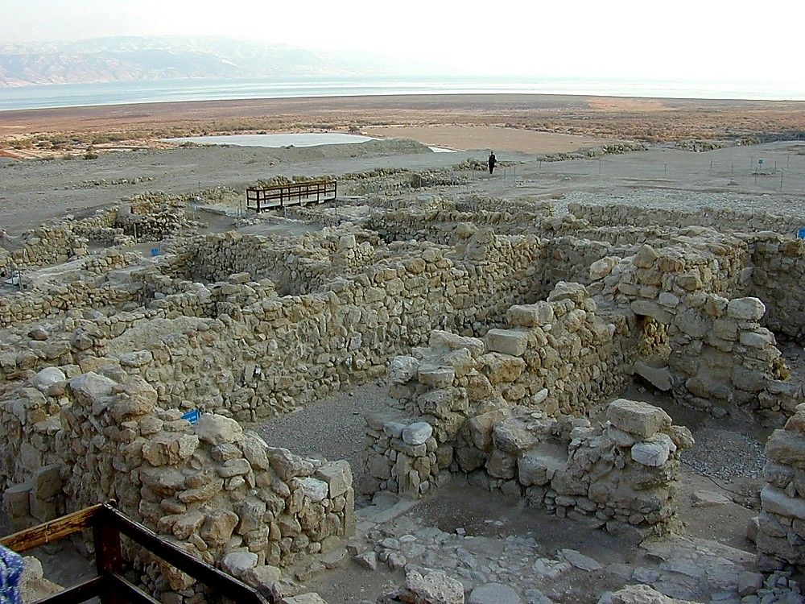
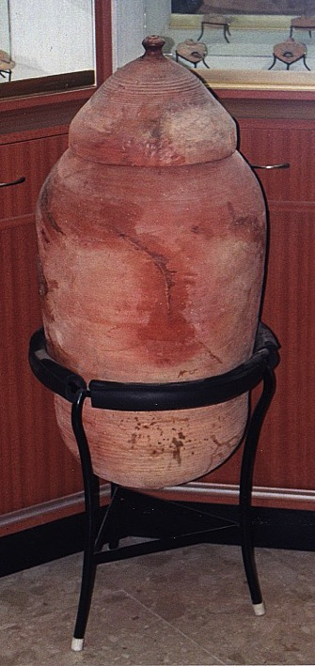
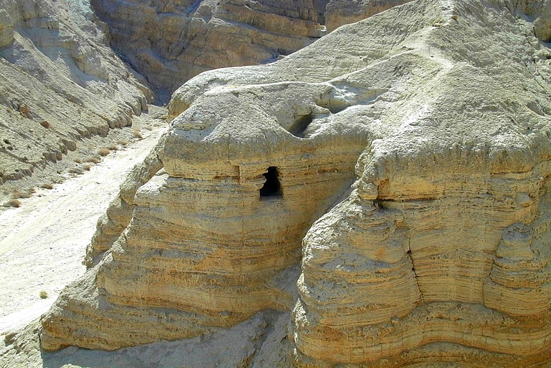
yifv,faopmvdyfrsm;awGU h&Sdonfhae&m
ysufpD;oGm;aom a&S;a[mif;cGef&ef QUMRAN, yifv,faourf;ajc&Sd vlae&yfuGuftarGteSpf
33
2

Slide 34
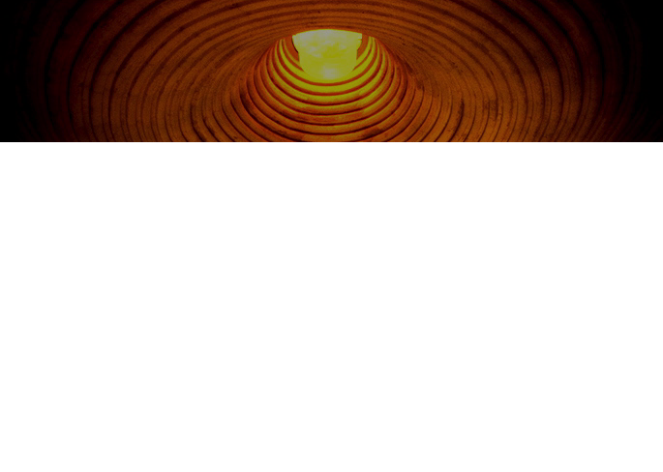
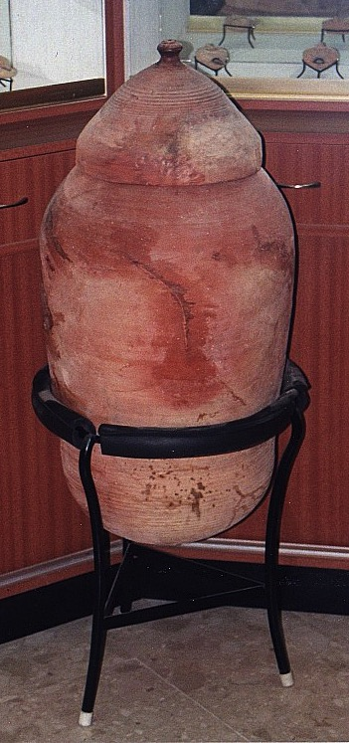
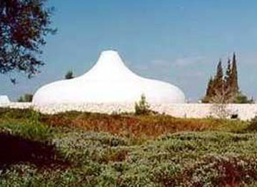
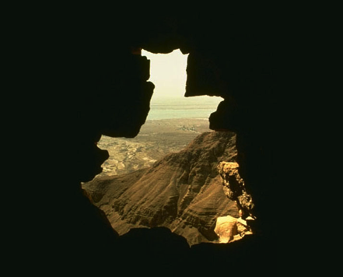
pmtkyf tkwf*l
tpfa&; edKifiHawmfordkif;jywdkuf/ a,&Sd&SvifjrdKhU
©2004 TBBMI
8.0.05a.
34
2

Slide 35
pmtkyf tkwf*l
tpPa&; edKifiHawmfordkif;_ywdkuf/ a,&k&Svif
pmtkyf tkwf*ltwGif;ykdif;
8.0.05a.
©2004 TBBMI
35

Slide 36
tmjA[HeSifh oufqdkifaomy#dnmOf
oifaxmuful trSwf -14
©2004 TBBMI
8.0.05a.
36
1

Slide 37
tmjA[HeSifh
oufqdkifaom
y#dnmOf
or®musrf;pm\ t"duusaom
“aBum&dk;”
tajctaeay:wGifrrlwnfaom bk&m;ocif\ tpDtpOf
þae&mwGiftpjyKonf
©2004 TBBMI
8.0.05a.
37

Slide 38
tmjA[HeSifh oufqdkifaomy#dnmOf
tmjA[Htm;zdwfac:jcif;
urÇm 12;1-3
tmjA[Hy#dnmOf
urÇm 15;9-18
or®musrf;\aBum&dk;wnf;[laom A[dktcsuftcsmtusqHk;aomt&m
tajctaeay:wGifrrlwnfaom bk&m;ocif\y#dnmOf
þae&mwGiftpjyKonf?
©2004 TBBMI
8.0.05a.
38
2

Slide 39
urBm 12;1-3
tm_A[HeSifhoufqdkifaom*wdawmfrsm;
1 xm0&bk&m;onfvnf; tm_AHudkac:awmfrlI/ oif._ynfeSifhwuG trsdK;om;csif;aygufaz:rsm;xJuxGuf_yD;v#if/ ig_yvwHhaom
_ynfodkhoGm;avmh?
a_rae&mwck
2 “igonfoifhudkvlrsdK;}uD;_zpfaprnf/ igaumif;}uD;ay;Ioif.emrudk}uD;_rwfaprnf? oifonf aumif;}uD;cH&aomol_zpfvdrfhrnf?
rsdK;aphwaph
tm _A [H
3 “oifhudk aumif;}uD;ay;aomoludkigaumif;}uD;ay;rnf? oifhudk usdefqJaomoludkigusdefqJrnf? oifhtm;_zifhvnf; vlrsdK;taygif;wdkhonf aumif;}uD;r*Fvmudk cH&}uvdrfhrnf[k rdefhawmfrl.?” (NIV)
The CALL
L - S - B
I - I
J - E
12
aumif;}uD;r*Fvm
39
8

Slide 40
tmjA[HeSifh oufqdkifaomy#dnmOf
tmjA[Htm;zdwfac:jcif; urÇm 12;1-3
y#dnmOf urÇm 15;9-18
ajrBuD;
rsdK;aph
aumif;BuD;r*Fvm
urÇm 12;1
urÇm 12;2
urÇm 12;3
or®musrf;pm\ tajccHaBum&kd;
©2004 TBBMI
8.0.05a.
40
2

Slide 41
urÇmOD;usrf; 12;1-3
tmjA[HeSifhoufqdkifonfh*wdawmfrsm;
1 “ xm0&bk&m;onfvnf; tmjAHudkac:awmfrlIí? oif\jynfeSifhwuG trsKd;om;csif;aygufaz:rsm;xJuxGufjyD;vQif? igjyvwHhaomjynfodkhoGm;avmh/
2 “igonf oif.udkvlrsKd;BuD;jzpfaprnf/ igaumif;BuD;ay;í oif.emrudkBuD;jrwfaprnf/ oifonf aumif;BuD;cH&aomoljzpfvdrfhrnf/
3 oifhudkaumif;BuD;ay;aomoludk igaumif;BuD;ay;rnf? oifhudkusdefqJaomoludk igusdefqJrnf? oifhtm;jzifhvnf; vlrsdK;taygif;wdkhonf aumif;BuD;r*Fvmudk cH&Buvdrfhrnf/
þ*wdpum;rsm;udkaemufwpfBudrfjyefBunfh vdkufyg/…
41

Slide 42
urÇmOD;usrf; 12;1-3
tmjA[HeSifhoufqdkifonfh*wdawmfrsm;
1“ xm0&bk&m;onfvnf; tmjAHudkac:awmfrlí? oif.jynfeSifhwuG trsKd;om;csif;aygufaz:rsm;xJuxGujyD;vQif? igjyvwHhaomjynfodkhoGm;avmh/
2 “igonf oif.tm;vlrsKd;BuD;jzpfaprnf/ igaumif;BuD;ay;í oif.emrudkBuD;jrwfaprnf/ oifonf aumif;BuD;cH&aomoljzpfvdrfhrnf/
3 oifhudkaumif;BuD;ay;aomoludk igaumif;BuD;ay;rnf/ oifhudkusdefqJaomoludk igusdefqJrnf/ oifhtm;jzifhvnf; vlrsdK;taygif;wdkhonf aumif;BuD;r*Fvmudk cH&Buvdrfhrnf/
þ*wdpum;rsm;udk wefzdk;xm;ygovm;/
42

Slide 43
urÇm 12;1-3
tmjAHeSifhoufqdkifaom *wdawmfrsm;
1 “ xm0&bk&m;onfvnf; tmjAHudkac:awmfrílI oif.jynfeSifhwuG trsdK;om;csif;aygufaz:rsm;xJuxGufjyD;vQif/
igjyvwHhaomjynfodkhoGm;avmh?
2“igonfoifhudkvlrsdK;BuD;jzpfaprnf? igaumif;BuD;ay; íoif.emrukdBuD;jrwfaprnf? oifonf aumif;BuD;cH&aomoljzpfvdrfhrnf?
3 oifhudk aumif;BuD;ay;aomoludk igaumif;BuD;ay;rnf? oifhudk usdefqJaomoludk igusdefqJrnf? oifhtm;jzifhvnf; vlrsdK;taygif;wdkhonf aumif;BuD;r*Fvmudk cH&Buvdrfhrnf[k rdefhawmfrl.\/ (NIV)
43

Slide 44
urÇm 12;1-3
tmjAHeSifhoufqdkifaom *wdawmfrsm;
1 “ xm0&bk&m;onfvnf; tmjAHudkac:awmfrlí? oif.jynfeSifhwuG trsdK;om;csif;aygufaz:rsm;xJuxGufjyD;vQif igjyvwHhaomjynfodkhoGm;avmh/
2“igonfoifhudk vlrsdK;BuD;jzpfaprnf/ igaumif;BuD;ay; íoif.emrudkBuD;jrwfaprnf/ oifonfaumif;BuD;cH&aomol jzpfvdrfhrnf/
3 oifhudkaumif;BuD;ay;aomoludk igaumif;BuD;ay;rnf? oifhudkusdefqJaomoludk igusdefqJrnf/ oifhtm;jzifhvnf; vlrsdK;taygif;wdkhonf aumif;BuD;r*Fvmudk cH&Buvdrfhrnf[k rdefhawmfrl.\/” (NIV)
*wdawmfrsm;tmjAHumvtcsdefuuJhodkh
,cktcsdefwGifvnf;cdkifvHí ktBuHK;0ifyg ao;ovm;?
wenf;…odkhr[kwf…rcdkifvHkaomt&mjzpfonf[kowfrSwfjyD; oify,fvdkaom or®musrf;ydk'f rsm;&Sdygovm;?
44
1

Slide 45
urÇm 12;1-3 tmjAHeSifhoufqdkifonfh*wdawmfrsm;
1 “ xm0&bk&m;onfvnf; tmjAHudkac:awmfrlI/ oif.jynfeSifhwuG trsKd;om;csif;aygufaz:rsm;xJuxGufyD;vQif igjyvwHhaomjynf odkhoGm;avmh?
2“igonfoifhudk vlrsKd;BuD;jzpfaprnf? igaumif;BuD;ay; í oif.emrudkBuD;jrwfaprnf? oifonfaumif;BuD;cH&aomol jzpfvdrfhrnf?
3 “oifhudkaumif;BuD;ay;aomoludk igaumif;BuD;ay;rnf? oifhudkusdefqJaomoludk igusdefqJrnf? oifhtm;jzifhvnf; vlrsKd;taygif;wdkhonf aumif;BuD;r*Fvmudk cH&Buvdrfhrnf[k rdefhawmfrl.\/” (NIV)
aumif;jyD/ jyD;awmh---… tjcm;aomt&mrsm; &Sdygao;ovm;?
45

Slide 46
tmjA[HeSifh oufqdkifaom y#dnmOf
tmjAHtm;zdwfac:jcif; urBm 12;1-3
y#dnmOf urBm 15;9-18
xm0&
urBm 13;15
a_r}uD;
rsKd;aph
aumif;}uD;
urBm 12;1
urBm 12;2
urBm 12;3
orRmusrf;pmausm&dk;
8.0.05a.
©2004 TBBMI
46

Slide 47
xm0& urÇm 13;15
¹⁵ oifjrifaomajrwjyifvHk;udk oifeSifh oif.trsKd;tEG,ftm; igonf umvtpOftjrJ ay;rnf? (NIV)
47
1

Slide 48
tmjA[HeSifh oufqdkifaomy#dnmOf
tmjAHtm;zdwfac:jcif; urÇm 12;1-3
y#dnmOf urÇm 15;9-18
xm0&
rl&if;
urÇm 13;15
urÇm 13;14-16
ajrBuD;
rsKd;aph
aumif;BuD;
urÇm 12;1
urÇm 12;2
urÇm 12;3
or®musrf;pm\ tajccHaBum&kd;
©2004 TBBMI
8.0.05a.
48

Slide 49
rl&if; -urÇmOD;13;14-17
¹⁴avmwonf tmjAHeSifhtwloGm; jyD;rS xm0&bk&m;onftmjAHudk ac:, íl oif&Sdaomt&yfrS awmif? ajrmuf? tah&S? taemufodkhf arsSmfBunfhavmh/
49

Slide 50
rl7if; - urÇmOD; 13;14-17
¹⁵ oifjrifaomajrwjyifvHk;udk oifeSifhoif.trsKd;tEG,ftm; igonf umvtpOftjrJ ay;rnf?
50

Slide 51
rl&if; - urBmOD; 13;14-17
¹⁶oif.trsKd;tEG,fudka_rr+efhuJhodkh igrsm;_ym;aprnf? odkh_zpfIvlonfa_rr+efh udka&wGufedKifv#if oif.trsKd;tEG,fudk a&wGufedkif}uvdrfhrnf?
51

Slide 52
rl&if; - urÇmOD; 13;14-17
¹⁷ oif\ajrudk tvsm;tm;jzifh4if;/ teHtm;jzifh4if;/ a&SmufoGm;avmh/oifhtm;igay;rnf[krdefhwmfrl.\/” (NIV)
52
1

Slide 53
tmjA[H y#dnmOf
tmjA[Htm;zdwfac:jcif; urÇmOD;usrf;
12;1-3
y#dnmOf urÇm15;9-18
tajctaeay:wGif rrlwnf aom
xm0&
rl&if;
urÇm 13;15
urÇm 13;14-16
urÇm 15;9-18
ajr
rsKd;aph
aumif;BuD;r*Fvm
urÇm 12;1
urÇm 12;2
urÇm 12;3
or®musrf;pm\ t"duaBum&kd;
©2004 TBBMI
8.0.05a.
53

Slide 54
tHhjobG,f&mvkyfaqmifyHk eSpfck
tajctaeay:wGifrllwnfaom oabmwlnDcsuf
“
xdkt&mudkoifvkyfaqmifvQif þt&mudkigjyKrnf
tajctaeay:wGifrrlwnfaom oabmwlnDrI
“t&mrsm;tm;vkH; igvkyfaqmifay;rnf/ avmavmq,foifjyKrjyK/ t"dur[kwf/”
54
5

Slide 55
tajctaeay:wGifrrlwnfaom
bk&m;ociff\y#dnmOf
urBm]D;usrf; 15;9-18
¹⁷wzefae0ifIrdkufaomtcg/ cGJxm; aomtom;tv,fY/ rD;ckd;xGufaom rD;zdk/ rD;xGef;vif;aomrD;cGufonf/ xif&Sm;pGma&SmufoGm; av.?
*þonfum; taoG;eSifhjyKvkyf&onfh y#dnmOfzGJUenf;jzpfownf;/
55
2

Slide 56
ta_ctaeay:wGifrrlwnfaom...
urBm]D;usrf; 15;9-18
¹⁸xdkaeUüxm0&bk&m;onf tmjAHeSif. y#dnmOfjyKawmfrlvsuftJ*kwÅKjrpfrS pljrpfBuD;wnf;[laom Oz&wfjrpfwdkif atmif/ xdkjynfudk4if; (NIV)
56

Slide 57
ueOD;umvü bk&m;ocifonf rdrdrdwfaqG tmjA[HeSifhy#dnmOfzGJUqdk&mwGif oabmwlnDrI*wday:wGiftajcrcHbJ taoG;awmfeSifhwzufowfqefqefy#dnmOfzGJUjcif;jzpfonf?
a[jAJ 6
¹³bk&m;ocifonftmjA[HESif.*wdxm; awmfrlaomtcg? udk,fawmfxufomvGefBuD;jrwfaomoludkwdkifwnfí usdefqdk&efr&SdaomaBumifh? udkk,fudkwdkifwnfíusdefqdkawmfrl\/ (NIV)
©2004 TBBMI
8.0.05a.
57
2

Slide 58
^{xdkUaemuf}
xm0&
*wdawmfrsm;onf xm0&wnfíf t"dyÜg,f&SdjyD; tajctaeay:wGifrrlwnfbJ jynfhpkHygonf?
rl&if;pmrSm
tajctaeay:wGif rrlwnfyg/
©2004 TBBMI
8.0.05a.
58
4

Slide 59
aemufqHk;wGif…wdkufxdyfzsm;odkh!
tmjA[Honfbk&m;ocifudk ,HkBunfaomaBumif. bk&m;ocifonf oltm; ajzmifhrwfaomol[lí owfrSwfonf?
urÇmOD;usrf; 15;6 (NIV)
59
3

Slide 60

arma&StwGuf bk&m;ocif\ txl;aqmif&Gufay;rI
I
II
III
IV
V
VI
VII
VIII
IX
X
"r®a[mif;usrf;xJrS
xGufajrmuf&musrf;
“arma&Sy#dnmOf”
pDpOfaqmif&GufyHk rnfodkhenf;?
©2004 TBBMI
8.0.05a.
60
3

Slide 61
I
II
III
IV
V
VI
VII
VIII
IX
X
oifaxmuful trSwf -15
61

Slide 62


တရားေဟာျခင္းအ တတ္ပညာ • BibleStudyDownloads.org
အခမဲ့အဘို့ဤတင်ပြချက်
Notes:
Preaching (pr)
Homiletics

Slide 63
Black

